Slide 1
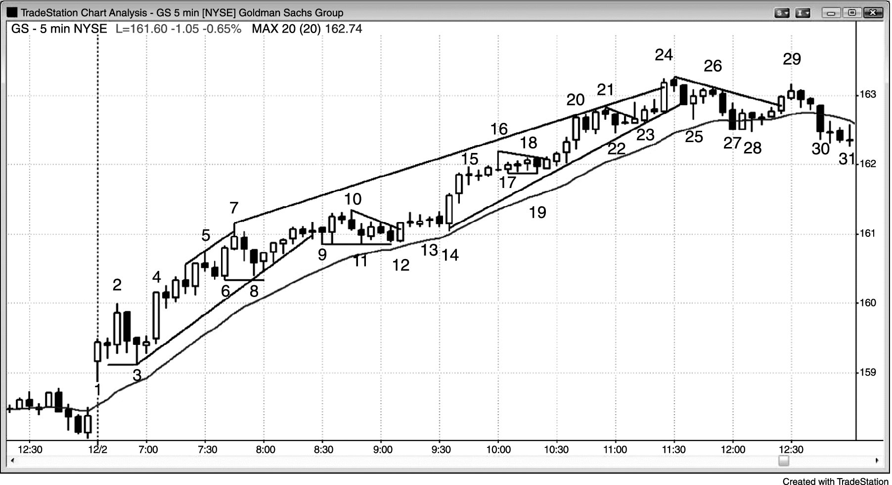
FIGURE 18.1 Strong Trend Day in GS

